Slide 1
Organizational culture and its impact on business
Expected learning outcome-
be able to understand the significance of organizational culture and its impact on business

Slide 2
Organizational Culture
Organizational Culture is a system of shared assumptions, values and beliefs that govern how people behave within an organization.
Culture is embedded in the behavior of individuals and can best be described as the personality of the organization.
https://www.youtube.com/watch?v=4cBN8xH-5Qw

Slide 3
……….
Organizational culture offers a shared system of meanings which is the basis for communications and mutual understanding.

Slide 4
MCQ
Which of the following terms is NOT included in the definition of organizational culture?
(A) Sensible procedures
(B) Ways of interacting
(C) Guides the behavior and thinking of organizational members
(D) Beliefs and value

Slide 5
Types of organizational Culture
Normative culture
Pragmatic culture
Academy culture
Baseball team culture
Club culture
Organization centric culture
Performance based culture
Process culture

Slide 6
Types of organizational Culture
Normative culture: standards, procedures, norms ,polices defined before and stick to them
Pragmatic culture: Customer satisfaction is main motto, customers are treated as God
Baseball team culture: contrast to pragmatic, employees the most precious asset
Academy culture: highly skilled employee, appropriate training programs
Club culture: promotions and appraisals, choosy about employees
Organization centric culture: profit is more important
Performance based culture: Performance of individual is important
Process culture: Employees work according to already established procedure.

Slide 7
MCQ
The culture that focuses on establishing norms and sticking to the same for carrying out operations in organizations is called –
A. Pragmatic culture
B. Normative culture
C. Academy culture
D. None of the above

Slide 8
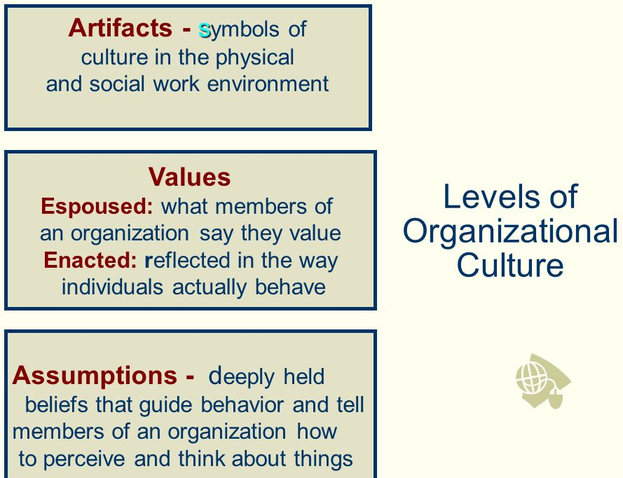

Slide 9
MCQ
An organization claiming that it emphasizes on continuous innovation is an example of -
A. Espoused culture
B. Enacted culture
C. Normative culture
D. None of the above

Slide 10
2
_____ is a shared system of meaning among employees.
Organizational systems
Collective sense making
Organizational culture
Cultural sensitivity

Slide 11
Elements of organizational Culture:
Heroes & Stories
Rituals and ceremonies
Language
Symbols
Belief, assumption and attitudes
Rules, norms and ethics
Mission and values
Climate and habits

Slide 12
Elements of organizational Culture
Stories: challenges faced in initial years, how issues resolved
Rituals and ceremonies: festivals , culture fest, events, celebration
Language and customs: slogans, transforming education transforming India
Symbols and symbolic action: clothing and office décor formals,
Belief, Assumption and attitudes: positive attitude change easily , negative attitude: show resistance
Rules, Norms and ethics:
Mission and values: Future course of action
Climate and habits: decided by the top management, conducive for employees . Ex: spend quality time with family
Heroes: Heroes are the founder members of the organization who have taken organization through exponential growth

Slide 13
MCQ
Which one of the following is not an element of organizational culture?
Stories
Poems
Rituals
Beliefs

Slide 14
Hofstede’s Cultural Dimension
Hofstede's cultural dimensions theory is a framework for cross-cultural communication, developed by Geert Hofstede.
It shows the effects of a society's culture on the values of its members, and how these values relate to behavior.

Slide 15
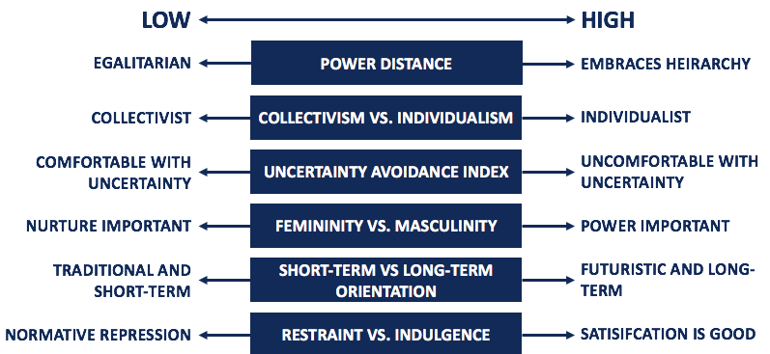
Hofstede’s Cultural Dimension

